Slide 1
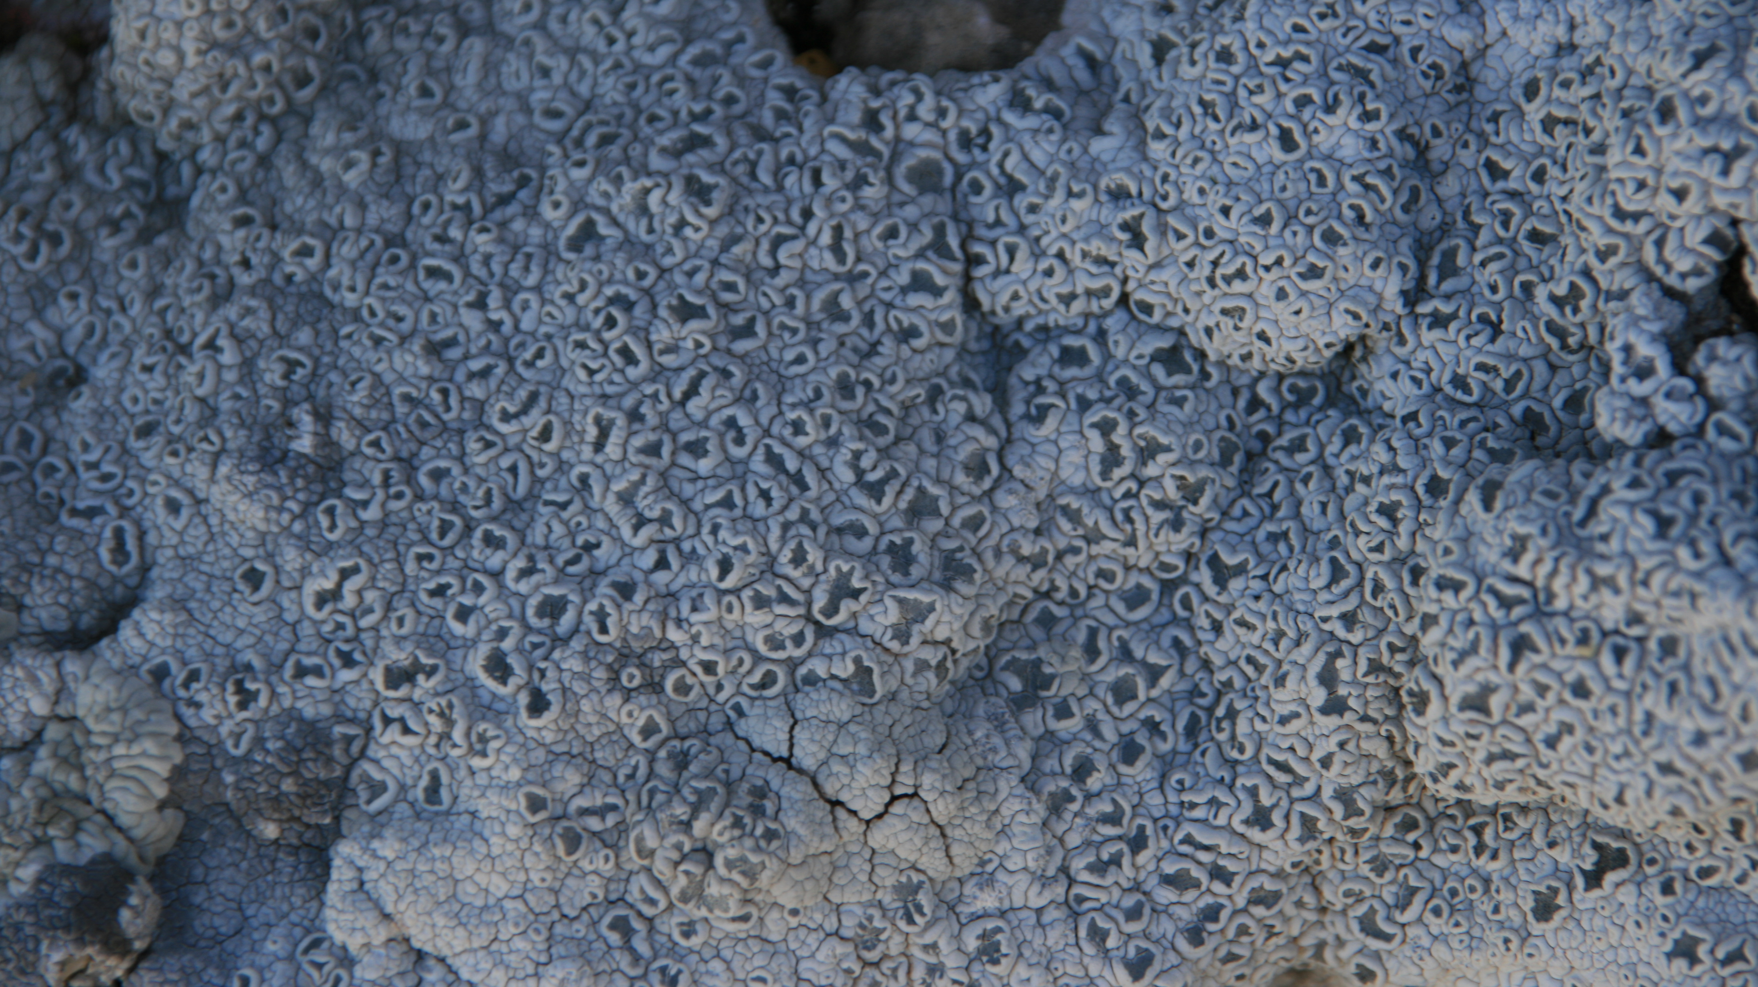
PCR-free/Cas9 mitochondrial enrichment
& long fragment sequencing
January 2021 - Ana & Moncho

Slide 2
Brief introduction to CRISPR-Cas systems
Ishino Y, Shinagawa H, et al. (1987) Nucleotide sequence of the iap gene, responsible for alkaline phosphatase isozyme conversion in Escherichia coli, and identification of the gene product. J Bacteriol 169(12):5429–5433.
CRISPR: Clustered Regularly Interspaced Short Palindromic Repeat - Mojica 1992. Found tandem repeats in halophile bacteria that coincided with Ishino’s sequence that must have had a function. In 1995 realized it had viral sequences from a common E.coli virus.
Mojica, F.J., Díez-Villaseñor, C., García-Martínez, J. et al. Intervening Sequences of Regularly Spaced Prokaryotic Repeats Derive from Foreign Genetic Elements. J Mol Evol 60, 174–182 (2005). – 60 strains of 50 species described
Hille F and Charpentier E (2016) CRISPR-Cas: biology, mechanisms and relevance. Philos Trans R Soc Lond B Biol Sci 371(1707):20150496.
CRISPR is a natural immune process used by bacteria to defend themselves against invading viruses -> could adapt CRISPR/Cas-dependent genome editing for use in mammalian cells

Slide 3
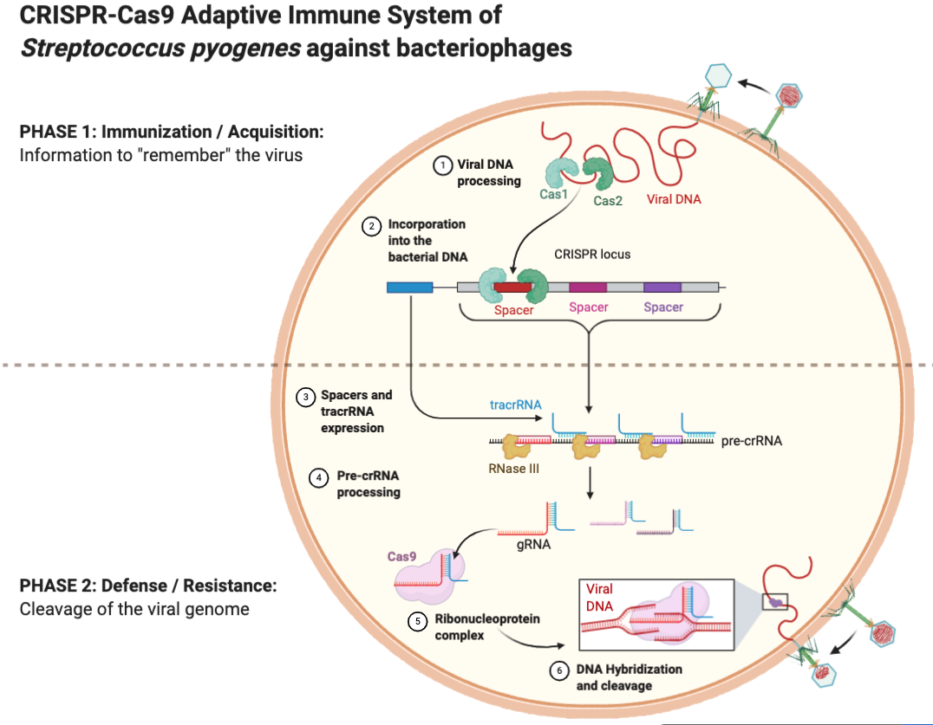
gDNA – guide RNA
tracrRNA - trans-activating CRISPR RNA

Slide 4
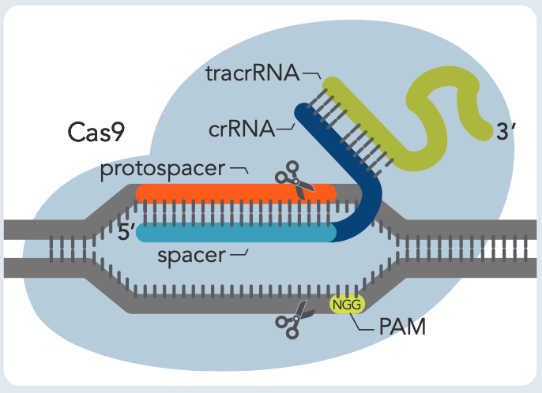
Cas (CRISPR-associated) enzymes
gDNA – guide RNA
crRNA – guideRNA + tracrRNA target
tracrRNA - trans-activating CRISPR RNA
PAM –protospacer adjacent motif
S. pyogenes
Acidaminococcus or Lachnospiraceae
20 bp guide RNA followed by PAM (NGG)
PAM (TTTV) followed by 20-24 (21) bp guide RNA
Cas12a Ultra high performance & can work at 30ºC

Slide 5
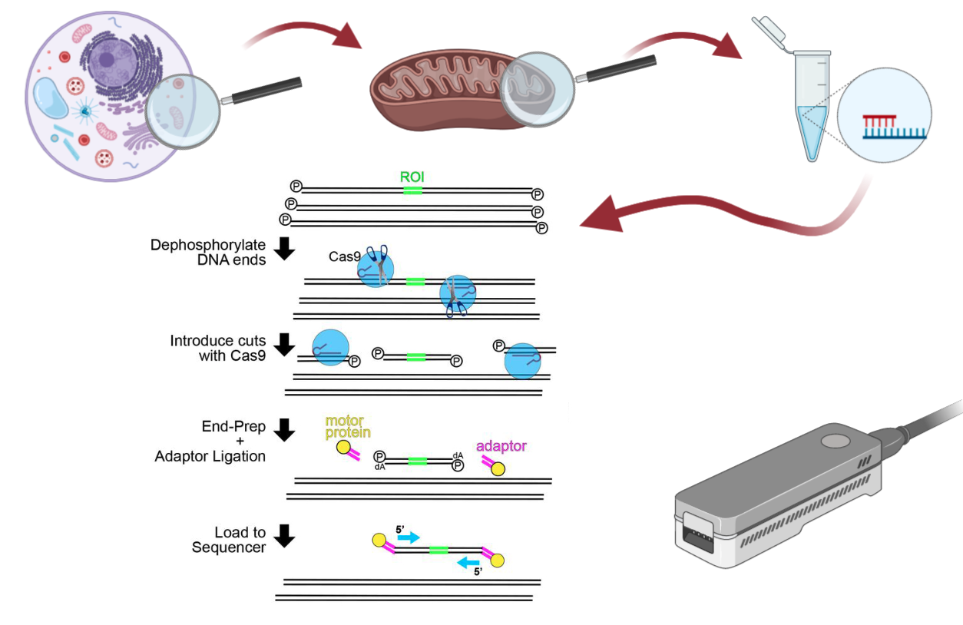
Nanopore Cas9-Targeted Sequencing, or “nCATS”
Gilpatrick, et al., 2019

Slide 6
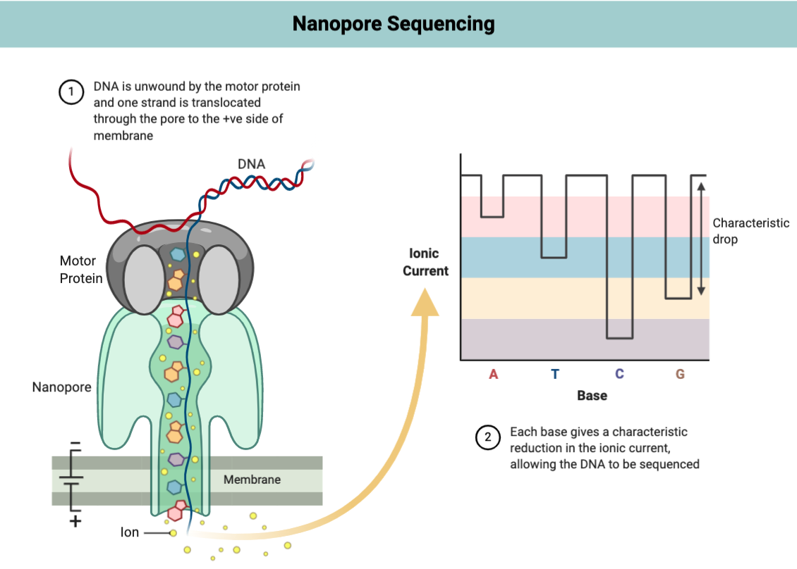
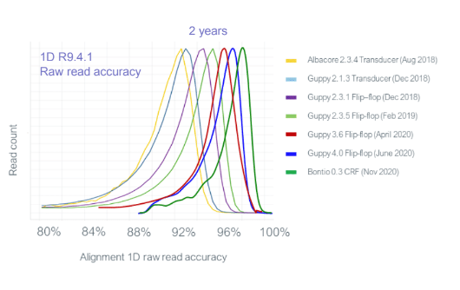

Slide 7
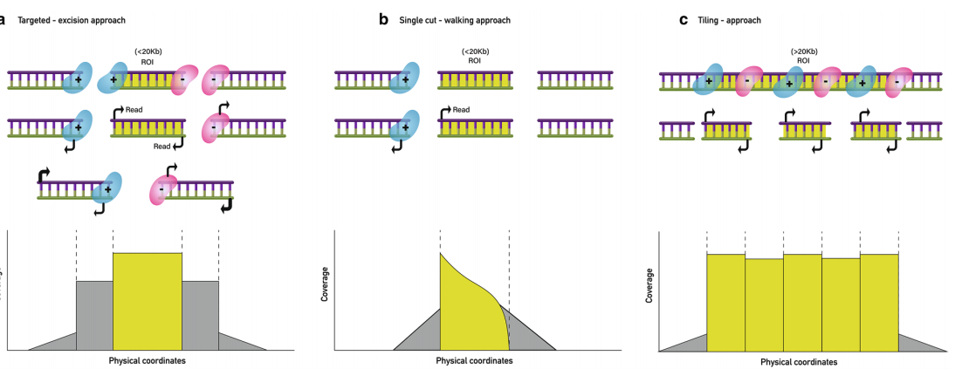
Determine the optimum number of cuts

Slide 8
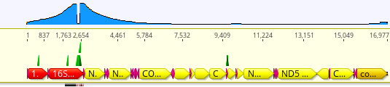
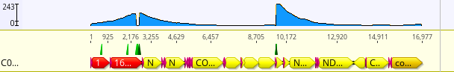
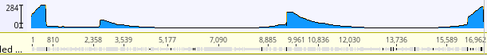
Sebastes pinniger | Flow cell | # guide RNA | Total seq | On target | % | Coverage | min | max | Longest
 |  |  |  |  |  | mean | min | max
#406 (210 ng/µl) | R9.4 | 2 | 33.51k | 512 | 1.52 | 50.6X | 1X | 223X | 11kbp
 | R9.4 | 3 | 17.25k | 573 | 3.32 | 56.5X | 0X | 243X | 7.25kbp
 | Flongle (R9.4) | 3 | 5.89k | 271 | 4.6 | 28.5 | 0X | 153X | 4.4kbp
#694 (210 ng/µl) | R9.4 | 5 (5µM) 15’dephos | 12.99k | 932 | 7.18 | 63X | 0X | 284X | 8.7kbp
 | Flongle (R9.4) | 5 (5µM) 15’dephos | 2.25k | 130 | 5.78 | 7.3X | 0X | 34X | 3.4kbp
 | R9.4 | 4 (10µM) 10’dephos | 68.1k | 1822 | 2.67 | 117X | 1X | 464X | 3kbp
#407(120 ng/µl) | R9.4 | 4 (10µM) 15’dephos | 16262 | 733 | 4.51 | 57X | 0X | 198X | 6.88kbp
nuclear:mitochondrial = 200:1 (bp)
??
nCATS enrichment

Slide 9
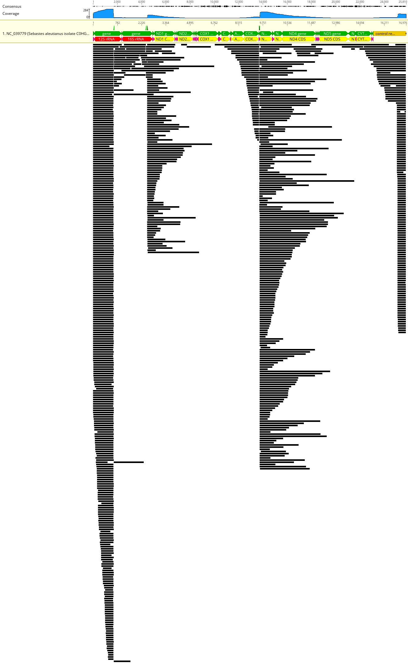
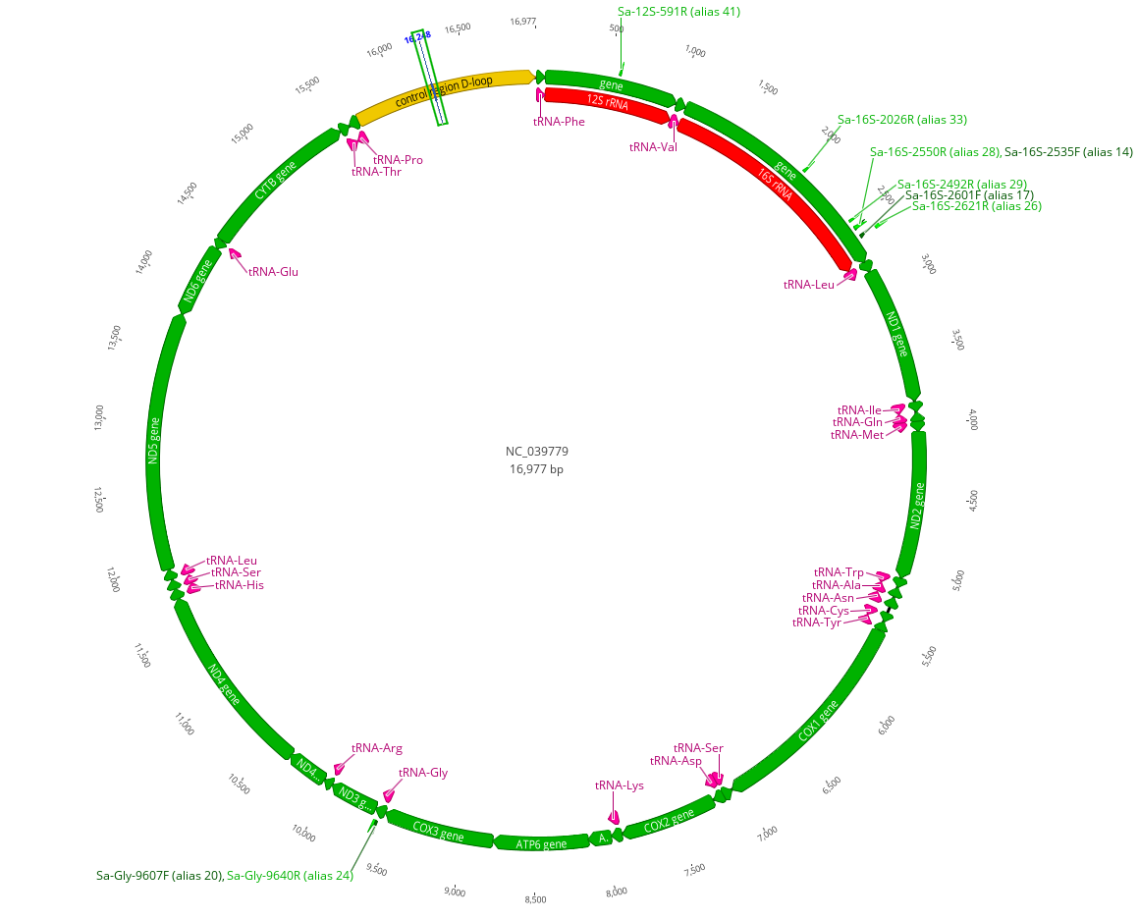
Sebastes aleutianus
591
2550 2535
Sebastes aleutianus
9640 9607
Sebastes pinniger
R9.4.1

Slide 10

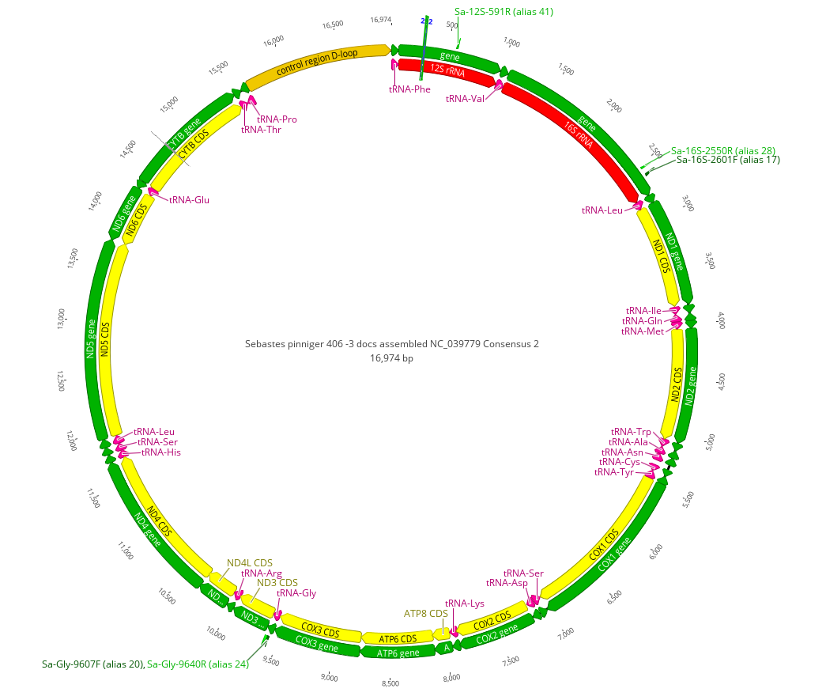
Map to reference, annotate and predict
Name | Match Bonito | Match Guppy4.2 | Match Guppy4.4 | Length Bonito | Length Guppy 4.2 | Length Guppy 4.4
tRNA-Phe | 100.00% | 98.53% | 95.59% | 68 | 67 | 68
12S rRNA | 100.00% | 99.63% | 99.05% | 941 | 938 | 939
tRNA-Val | 100.00% | 100.00% | 100.00% | 72 | 72 | 72
16S rRNA | 100.00% | 99.90% | 98.35% | 1688 | 1687 | 1688
tRNA-Leu | 100.00% | 100.00% | 100.00% | 74 | 74 | 74
ND1 gene | 100.00% | 100.00% | 95.18% | 975 | 975 | 975
tRNA-Ile | 100.00% | 100.00% | 97.10% | 68 | 68 | 67
tRNA-Gln | 100.00% | 100.00% | 97.18% | 71 | 71 | 71
tRNA-Met | 100.00% | 100.00% | 100.00% | 71 | 71 | 71
ND2 gene | 99.93% | 99.59% | 94.69% | 1043 | 1045 | 1043
tRNA-Trp | 100.00% | 100.00% | 100.00% | 71 | 70 | 71
tRNA-Ala | 100.00% | 100.00% | 100.00% | 69 | 69 | 69
tRNA-Asn | 100.00% | 100.00% | 97.22% | 72 | 72 | 72
tRNA-Cys | 100.00% | 98.46% | 98.41% | 64 | 65 | 64
tRNA-Tyr | 98.91% | 98.24% | 97.10% | 71 | 71 | 71
COX1 gene | 99.22% | 97.97% | 93.78% | 1553 | 1548 | 1551
tRNA-Ser | 94.86% | 91.78% | 85.33% | 74 | 71 | 71
COX2 gene |  | 95.93% | 93.98% |  | 685 | 689
tRNA-Lys | 98.51% | 98.63% | 98.63% | 168 | 74 | 74
ATP8 gene | 98.98% | 100.00% | 98.21% | 683 | 168 | 168
ATP6 gene | 100.00% | 99.56% | 95.88% | 784 | 680 | 679
COX3 gene | 100.00% | 99.78% | 96.68% | 72 | 783 | 784
tRNA-Gly | 100.00% | 98.46% | 100.00% | 351 | 72 | 72
ND3 gene | 100.00% | 100.00% | 96.85% | 69 | 351 | 349
tRNA-Arg | 100.00% | 100.00% | 98.55% | 297 | 69 | 69
ND4 gene | 100.00% | 100.00% | 94.93% | 1385 | 1385 | 1381
tRNA-His | 100.00% | 100.00% | 100.00% | 69 | 69 | 69
tRNA-Ser | 100.00% | 100.00% | 100.00% | 68 | 68 | 68
tRNA-Leu | 100.00% | 100.00% | 100.00% | 73 | 73 | 73
ND5 gene | 98.25% | 98.06% | 93.84% | 1822 | 1825 | 1822
ND6 gene | 96.53% | 96.05% | 91.93% | 517 | 516 | 513
tRNA-Glu | 95.77% | 89.67% |  | 71 | 75
CYTB gene | 96.11% | 93.67% | 93.77% | 1146 | 1142 | 1158
tRNA-Thr | 100.00% | 100.00% | 95.83% | 72 | 72 | 72
tRNA-Pro | 100.00% | 100.00% | 100.00% | 70 | 70 | 70
control region | 98.92% | 99.03% | 84.55% | 1319 | 1312 | 1313
Bonito: 864 seq, Mean: 44.1 Std Dev: 61.6, 0X - 264X Consensus: 16,952 bp Ref-Seq: 95.9% (16,279 of 16,977)
Guppy4.2: 932 seq, Mean: 51.9 Std Dev: 69.6, 0X - 283X Consensus: 16,949 bp Ref-Seq: 99.7% (16,931 of 16,977)
Guppy4.4: 904 seq, Mean: 51.2 Std Dev: 68.9, 0X - 284X Consensus: 17,078 bp Ref-Seq: 99.7% (16,932 of 16,977)
R9.4.1

Slide 11
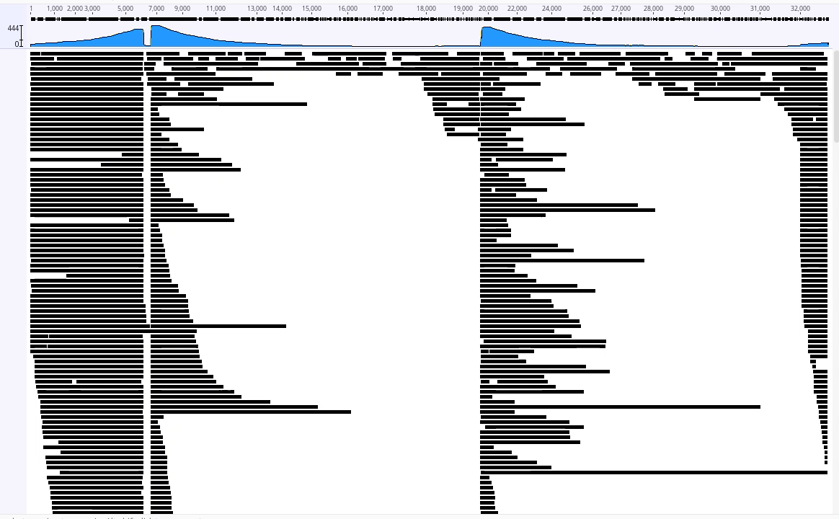

Slide 12
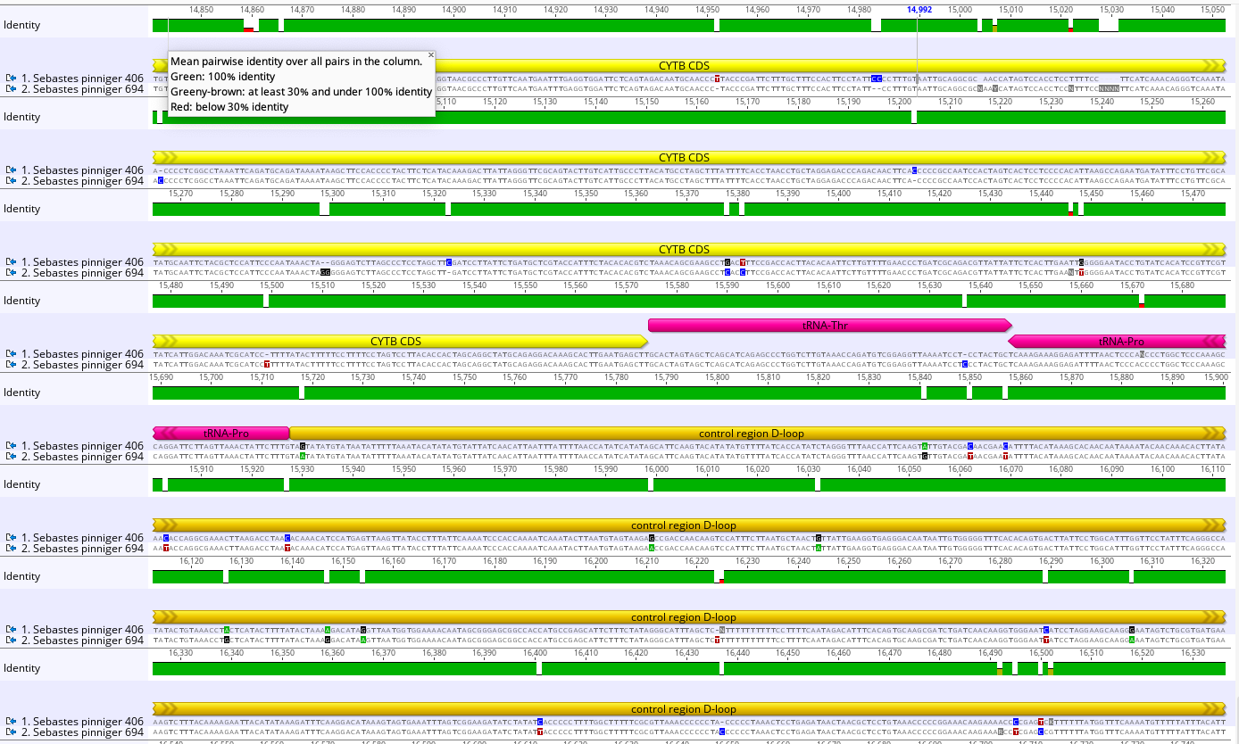
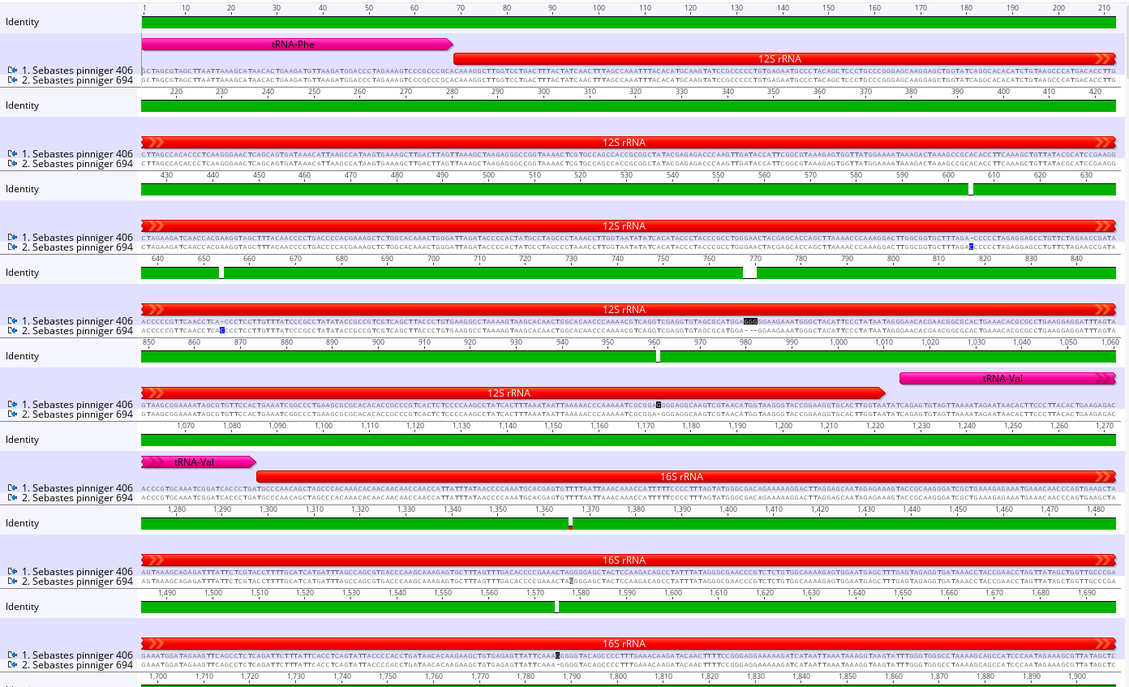
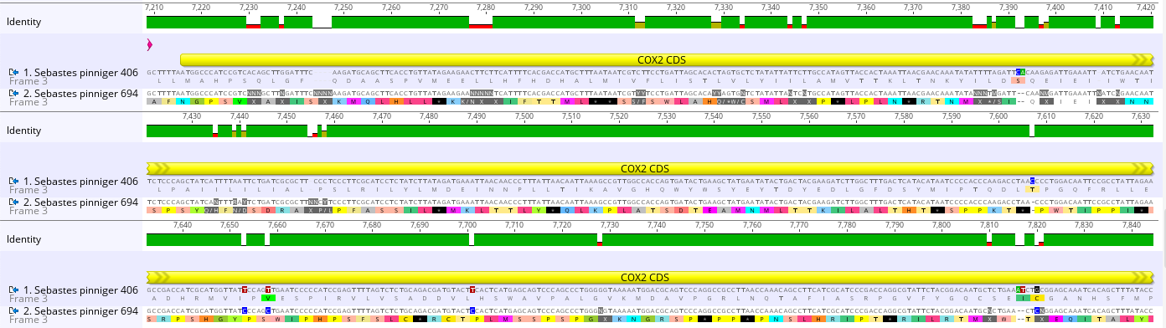

Slide 13
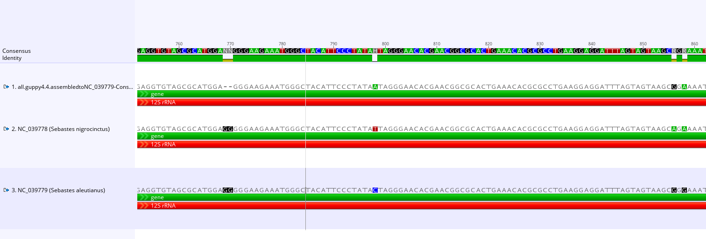
Flow cell R9.4.1 Sebastes pinniger consensus vs S. nigrocinctus & S. aleutianus

Slide 14
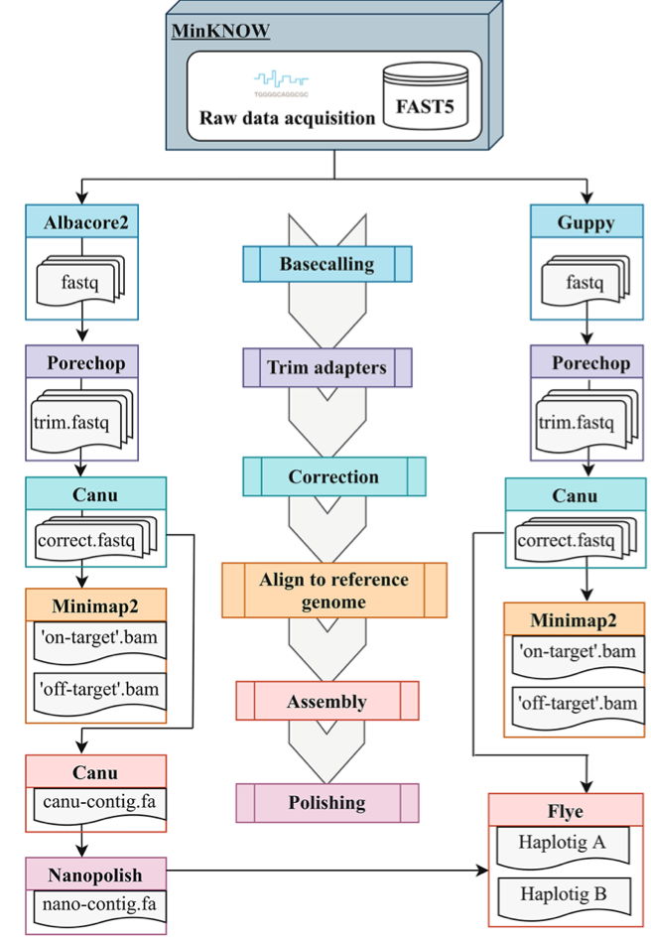

Data analysis - Bioinformatics
Fast5 to Fasta: MinKNOW (Guppy and Bonito)
Adapter trimming: Porechop
Nanopolish
Canu
dinumt (to identify NumtS)?
Map to reference genome: Minimap2 (in Geneious)
Annotation: Geneious /MitoFish/MITOS/GeSeq/MitoZ
López-Girona et al. (2020). "CRISPR-Cas9 enrichment and long read sequencing for fine mapping in plants." Plant Methods 16(1): 1-13.

Slide 15
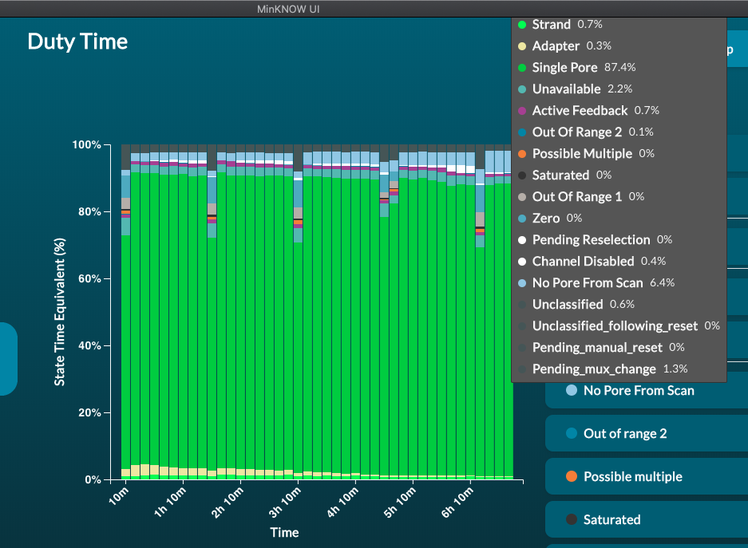
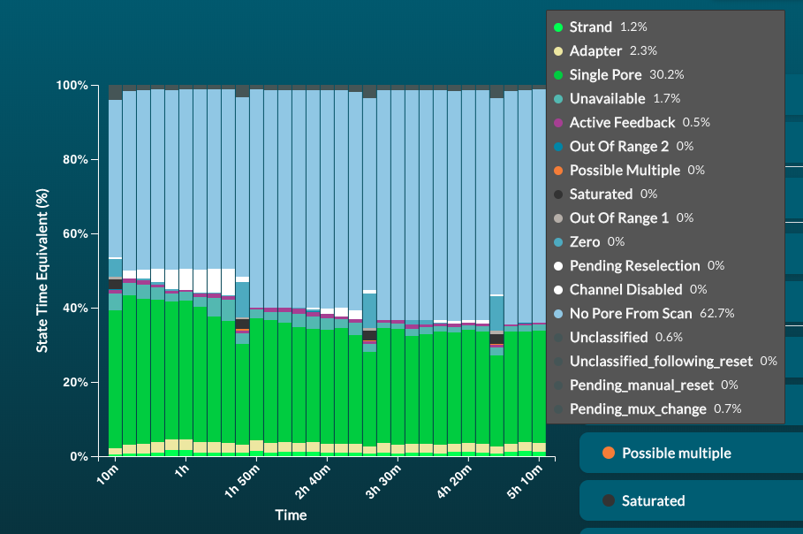
Low pore occupancy in flow cell and flongle that kills the pores

Slide 16
Challenges and considerations
Coverage between 0x and 284x
Most regions are well covered but COI, COII, ND5 and cytb that have some fragments at 1x-3x (>93 % with aleutianus). All genes except D-loop > 95 % match
Aiming longer fragments and more coverage in certain regions
<1% pore occupancy (or 3% with adapters) -> multiple samples in one run
ONT long fragments error vs Illumina genome skimming (<300bp) PCR bias at AT-rich regions
Long fragment will guarantee mitochondrial origin and avoid nuclear mitochondrial segments

Slide 17
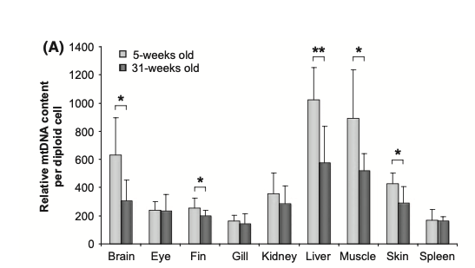
Next steps
Nothobranchius furzeri
Hartmann et al (2011)
Increase the yield (and on-target/off-target ratio?)
Validate the method and build mitogenome database
liver or muscle with phenol-chloroform extraction to get high [long fragment DNA] (use phase lock or wide-bore tips) vs mitochondrial DNA isolation kit
12 barcoded species MinION vs 1-3 species Flongle
16S

Slide 18
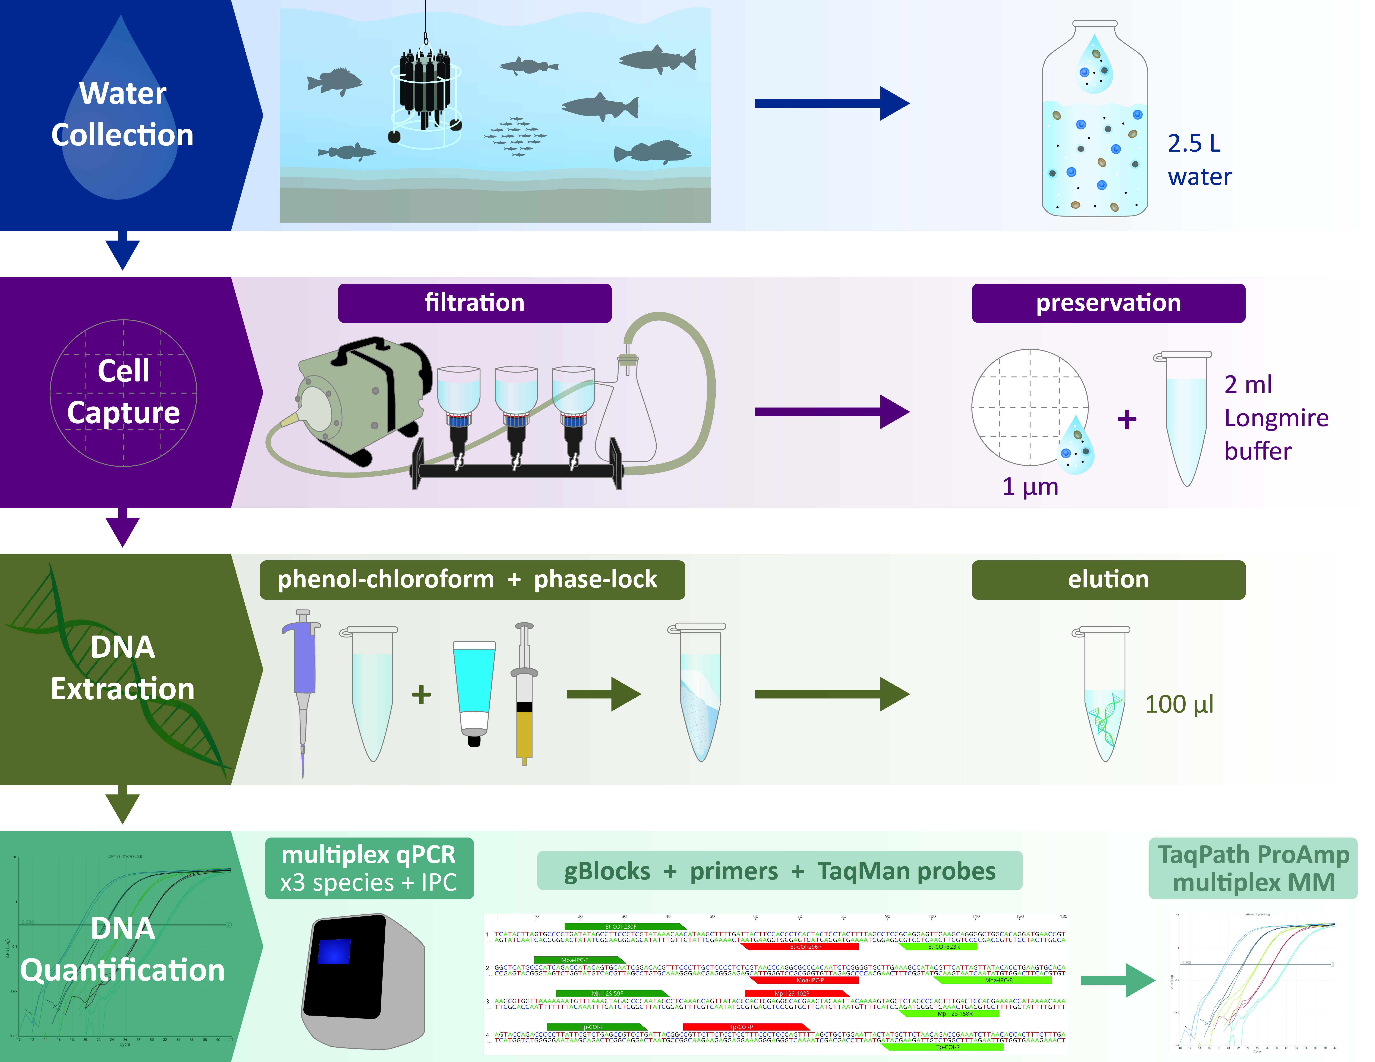
eDNA: free PCR sequencing?
Aim: nCATS on eDNA samples for identification and population genetics
Constraints: low [target DNA] + inaccuracy of single sequences vs consensus
Typical DNA preparations comprise approximately 0.1% mtDNA, even though there are hundreds to tens of thousands copies of mtDNA per cell
eDNA sample library tested had 1632 copies of the 12S fragment

Slide 19
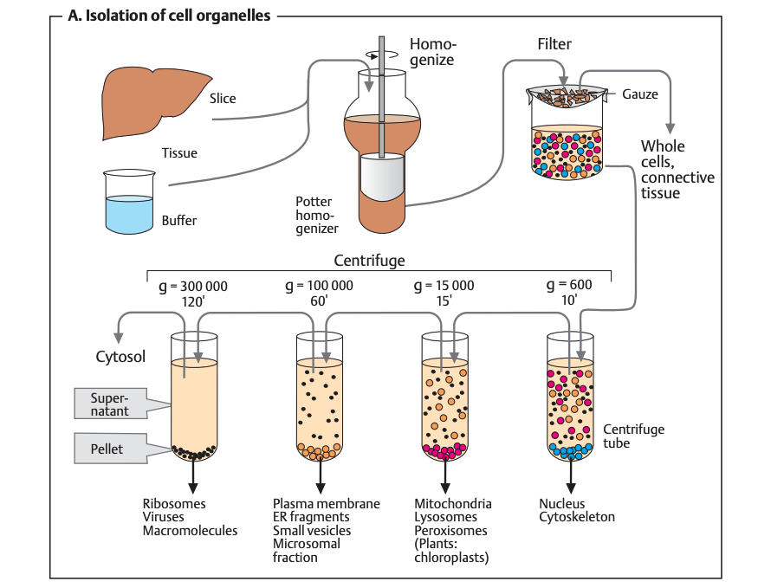
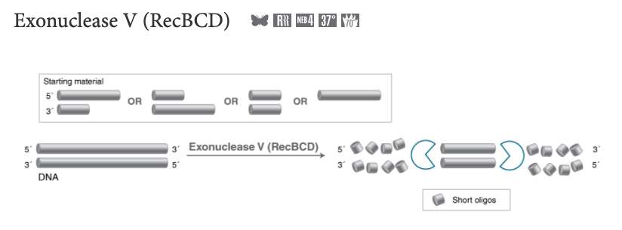
Test extraction methods: - Phenol-chloroform - Mitochondrial DNA isolation kit
Koolman & Roehm (2005). Color Atlas of Biochemistry
Next steps
Tissue (fresh liver/muscle):
DNA yield
Ratio on/off target
Length of fragments
Best number of guide RNAs
eDNA:
gDNA depletion (exonuclease) or mitDNA isolation kit/procedure
mitDNA amplification (REPLI-g single cell, Phi29) – 8 h incubation
linearize and sequencing
Notes:
dure

Slide 20
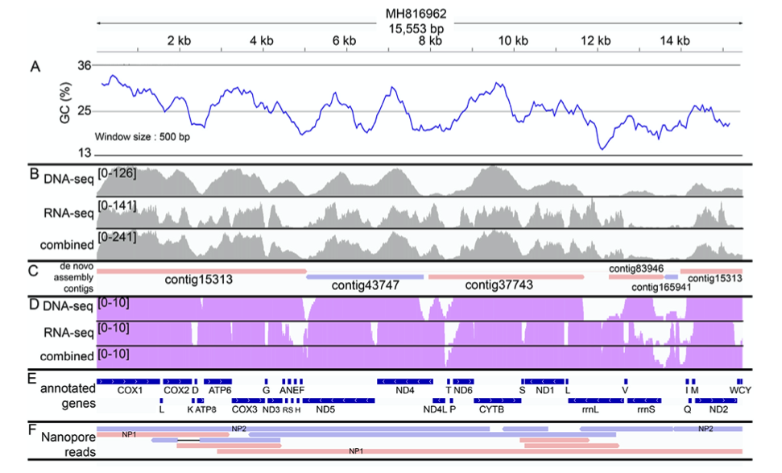
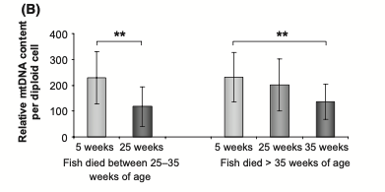
Potential applications
Gan et al 2019
Build databases
eDNA metabarcoding? Population genetics?
Could eDNA serve as a field method to confirm/correct acoustic signals?
Long reads from Nanopore preserve gene order and thus can support Illumina reads
Aging analysis by nCATS – biopsy tissue to study fitness (age associated deletions/shorter fragments in many vertebrates and mitochondria number decrease)
Signal and isolation of target single cells sorting using Cas and FACS

Slide 21
Transfection/electroporation with dCas9 tracrRNA – ATTO™ 550 RNP at 1.5 µM for 24 h
microfluidics
Ishii et al 2019
FACS – fluorescence activated cell selection
dCas9 does not cut the DNA

Slide 22
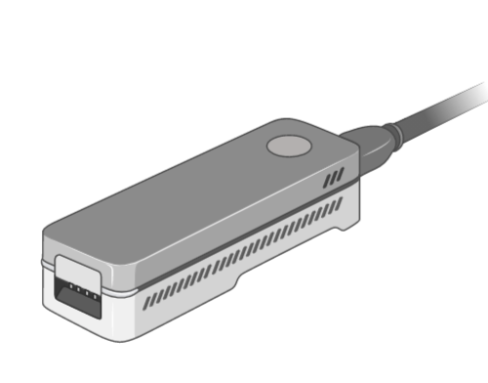

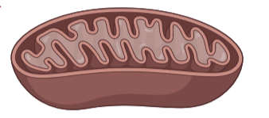
Plan
Tapestation and Qubit (broad range)
PCI could be replaced by Circulomics HMW kit @ remote lab
Try Ampure for size selection as in Quispe-Tintaya that uses 0.4X and Qiagen Spin miniprep kit for plasmids
LSK109
PCI / Circulomics (+SRE)
gDNA depletion
RAD004 to linearize
LSK109
Mit ext. kit / plasmid kit
gDNA depletion?n
lrPCR with 16Sprimers
gDNA depletion
REPLIg single cell
PCI
REPLIg single cell
Mit ext. kit

Slide 23
Literature and tests – mitogenomes from tissue
Paper | extraction | Treatment for enrichment | Fold enrich. | test | sequencing | ONT | Comments
Quispe-Titaya 2013 | QIAprep Spin Miniprep Kit | Ampure 0.4x and resuspend in 25 ul | 2028x | qPCR |  |  | Compared vs Biovision
Dhome-Pollet 2020 |  | Exonuclease V (10 U 2h) (+ REPLI gmit), T7 endonuclease for debranching | 3700X (10000X) | qPCR | 20% mit, 118-488X at >8kbp | NBD103+LSK109 | Uses primers at REPLIg
Franco-Sierra 2020 | Phenol-chlor+phase lock (25 mg liver) | 3 ug to sequencing |  |  | 0.53% mit, 127 reads >6kbp >30X | LSK108 | Thorough test of the pipeline
Baloglu 2021 |  | PCR metabarcoding and RCA, T7 endonuclease for debranching
extraction | enrichment | Guide RNA # | sequencing
Phenol-chloroform | 5-10uM nCATS, dephosphorylation time | 5 -> 3 -> 2 ->1 | LSK109
Phenol-chloroform | Exonuclease |  | LRK001 / RAD001
Phenol-chloroform | Exonuclease + nCATS |  | LSK109
Circulomics |  |  | LRK001 / RAD001
Circulomics | SFE XS (+Ampure XP?) |  | LRK001 / RAD001
Circulomics | nCATS |  | LSK109
Biovision mitochondrial kit |  |  | LRK001 / RAD001
Biovision mitochondrial kit | nCATS |  | LSK109
QIA Spin miniprep |  |  | LRK001 / RAD001
Tapestation and Qubit (broad range)
Chinook, eulachon+hake qPCR

